Slide 1

CYBER SECURITY
by
Bhargavi. P
Roll No. 204G1A3204
Department of Computer Science and Engineering
Srinivasa Ramanujan Institute of Technology
Autonomous
Rotarypuram Village, B K Samudram Mandal, Ananthapuramu – 515701.
2022-2023

Slide 2

Contents
Introduction
Modules
Modules Explanation
Conclusion
References

Slide 3
Introduction
Cyber Security is the act of defending technology such as computers, servers, and mobile devices as well as Electroinic systems, networks and data from malicious attacks or cyber attacks also known as Information Technology Security. It also comprises some sub-branches. These are: Network Security, Web Security, Mobile Security etc..
Cyber attackers are becoming more innovative and users having more than one devices. There are many cyber attacks some of them are: Malware Attack, Phishing Attack, Password Attack, Watering Hole Attack etc..
I did the internship under AICTE. AICTE was set up in November 1945 as a national-level apex advisory body to conduct a survey on the factilities available for technical education and to promote development in the country in a coordinated and integrated manner.
AICTE was constituted to provide for the establishement of an All India Council for Technical Education with a view to proper planning and co-ordinated development of a technical education system throughout the country.

Slide 4
Modules
The cybersecurity internship includes four modules. These are:
Introduction to Cybersecurity.
Fundamentals of Network Security.
Fundamentals of Cloud Security.
The Fundamentals of Security Operations Center(SOC).

Slide 5
Introduction to Cybersecurity
Cybersecurity is all about reducing threats when people are in the process of dealing with the technology. It encompasses the full range of protection against any online risk or vulnerability.
For securing any organisation , system, application, network or devices we need to know the different ways through which cyber attacks are possible. Some of them are:
Malware
Man in the Middle(MITM)
Phishing
Password attacks etc..
Some of the most common types of malware attacks to system are: Viruses, worms, trojans, etc…Through the vulnerability the system may got attacked. Its means that vulnerability can allow the attacker to manipulate the system and it can be caused by complexity connectivity, poor password management etc. Exploit is a tool that take advantage of this vulnerability and those are used to execute malicious code.
Attackers will commonly uses phishing emails to distribute malicious links that can perform a variety of functions i.e., extracting login details etc…

Slide 6
Fundamentals of Network Security
Network security protects the network and data from breaches and other threats. Network security is vital in protecting client data and shared data secure and ensuring reliable access as well as protection from cyber attacks.
The three main components to ensure security are: confidentiality, integrity, availability. The most common network devices are : hubs, router , access point, switches etc..
IP addresses plays a major role in network security which are used to identify who or what is connected to your network or devices.
An IP address is a unique address that identifies a device on the internet or network. It is a 32-bit series of numbers . This IP address includes subnetting strategy to improve network performance and speed.
This fundamentals of network security includes network security technologies, and IDS,IPS. An intrusion detection system(IDS) is a passive monitoring solution for detecting cybersecurity threats and generates an alret that notifies security personnel to investigate the incident and take action. An intrusion prevention system(IPS) is an active protection system. It raises an alret and take remediate action on identified action.
Network security involves virus and antivirus software, endpoint, VPN encryption and email security etc…

Slide 7
Fundamentals of Cloud Security
Cloud security is also known as cloud computing security is a collection of security, measures designed to protect cloud based infrastructure, applications and data.
There are three types of cloud computing models. They are:
Infrastructure as a Service(IaaS): IaaS is a type of cloud computing sevice that offers essiential compute, storage, and networking resources on demand.
Platform as a Service(PaaS): PaaS is a complete development and deployment environment in the cloud that includes everything developers need to build, run, and manage applications.
Software as a Service(SaaS): It is a software distributed model in which a cloud provider hosts applications and makes them available to end users over the internet.
In this module DevOps are explained that unites teams to discover and remediate issues. DevOps combines and automates software development and IT operations into teams that work together.
In this cloud security we uses SASE (Secure Access Service Edge)security model can help any organisation. We can implement threat prevention, web filtering, data loss prevention etc.

Slide 8
The Fundamentals of Security Operations Center(SOC)
SOC is a environment or physical facility where various security experts monitor and control enterprise systems and networks, prevent security breaches and identify and mitigate security threats.
This module introduce the security Operations frameworks, people, processes and technology aspects required to support the business.
The SOC team implements the organizations overall cybersecurity strategy and acts as the central point of collaboration in coordinated efforts to monitor, assess and defend against cyberattacks.
There are six elements of security operations. They are :
Business
People
Interfaces
Technology
Processes

Slide 9
Conclusion
Cyber Security is one of the most important aspects of the fast-paced growing digital world. The threats of it is hard deny, so it is crucial to learn how to defend from them.
To avoid the cyber security attacks everyone has to follow some tips or instructions :
Install and regularly update antivirus software for every computer. Don’t buy the cheapest software.
Protect your internet connection by using a firewall.
Make backup copies for important data and keep them safe.
Train employees or family members about cyber security and its principles.
Regularly change password and use strong passwords.
Regularly update computer software and operating systems.
Secure the network. VPNs are highly related to cyber security.

Slide 10
References
https://internship.aicte-india.org
https://www.paloaltonetworks.com

Slide 11
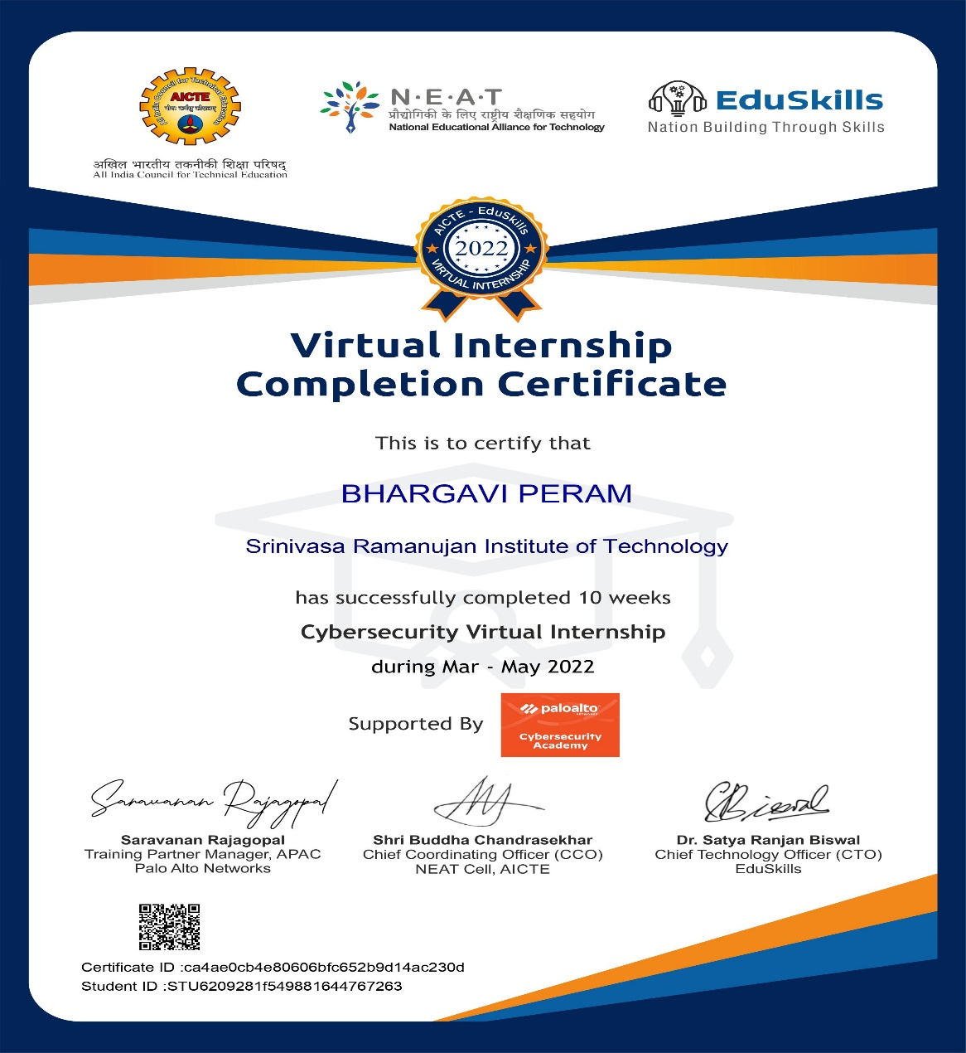
Internship Certificate

Slide 12
Thank You!!!

